Slide 1
You say you are an agent, on a market, in South Africa?
11 August 2022
Francois Knowles

Slide 2
The elephants in the Room!

Slide 3
APAC’s mandate
Our Objective:
To regulate the occupations of fresh produce, export and livestock agents and to maintain the status and dignity of those occupations and the integrity of those practicing those occupations.
Section 9 of the Agricultural Produce Agents Act, Act 12 of 1992.

Slide 4
Back to basics
Regulate (who)
The occupation of a fresh produce agent.
Section 22 of the Constitution, 1996 (Bill of Rights) - Freedom of trade, occupation and profession. Every citizen has the right to choose their trade, occupation or profession freely. The practice of a trade, occupation or profession may be regulated by law.
Maintain (what)
The status and dignity of that occupation.
The integrity of those practicing that occupation.
How?
Training, “unconditional” support & the right narrative.
The agriculture and agro-processing masterplan.

Slide 5
Career Pathing Programme
As part of achieving one of its core focus areas, APAC is working towards promoting a career pathing programme, which identifies and encourages those at agencies to follow a programme towards becoming fresh produce agents.
PACKER
GATE CHECKER
CONSIGNMENT HANDLER
BOOKING CLERK
JUNIOR SALESPERSON
COMMISSION AGENT
STORE CHECKER

Slide 6
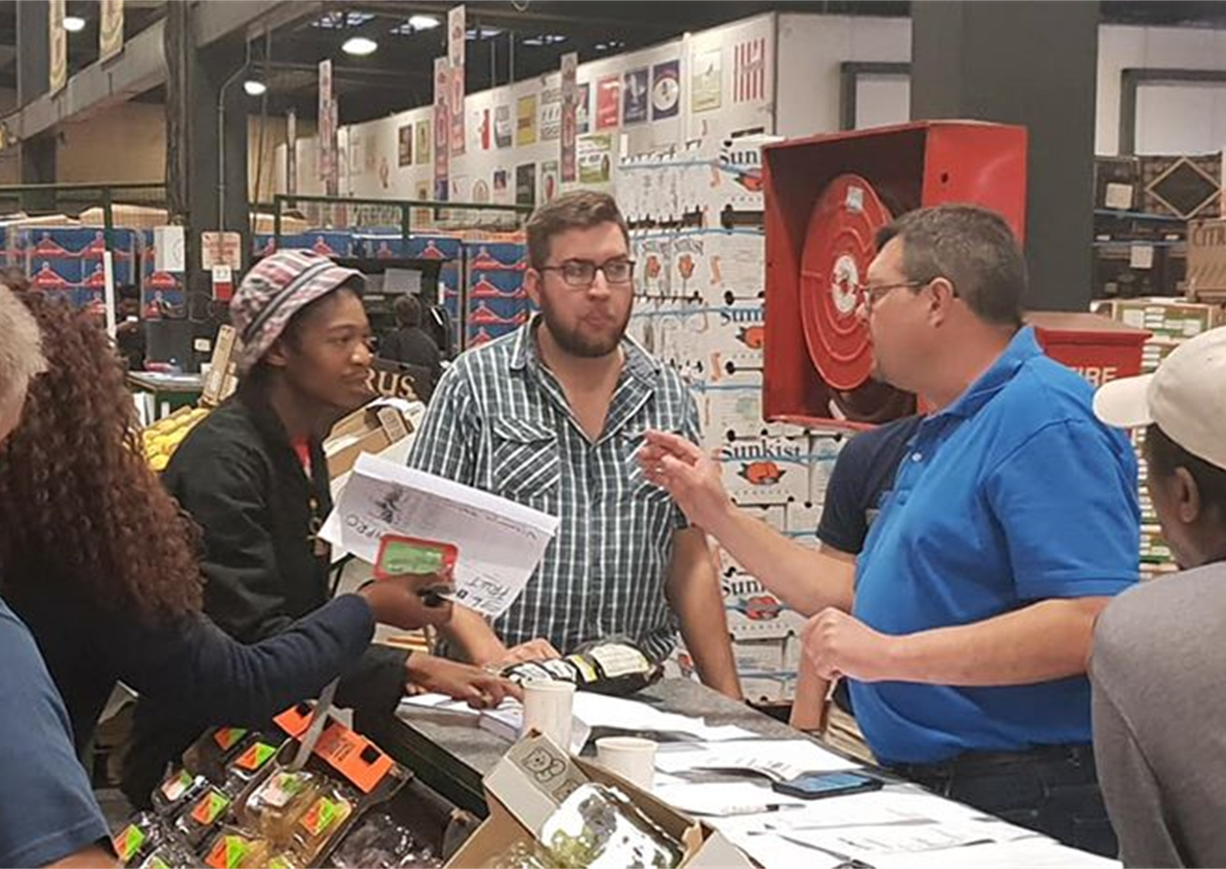
Who is an agent?
An agent is a person who acts on behalf of a principal, by selling the principal's produce to buyers such as hawkers, wholesalers and retailers. Most agents operate on fresh produce markets.
Prices of fresh produce is not predetermined but discovered in terms of the supply and demand principle.
What does the perfect agent look like?

Slide 7
The “Perfect” Agent

Slide 8
What is Price Discovery?
Price discovery is the overall process, whether explicit or inferred, of setting the spot price or the proper price of a commodity (in this case fresh produce). The process of price discovery looks at a number of tangible and intangible factors, including supply and demand, quality, and the overall economic and geopolitical environment. Simply put, it is where a buyer and a seller agree on a price and a transaction occurs.

Slide 9
The Agent & price discovery
Supply & demand?
Free Market System (Rules)
Information
Turnover & Mass figures

Slide 10
The Constitution and information
Section 32. of the Constitution, 1996. Access to information.
1. Everyone has the right of access to-
(a) any information held by the state; and
(b) any information that is held by another person and that is required for the exercise or protection of any rights.
2. National legislation must be enacted to give effect to this right and may provide for reasonable measures to alleviate the administrative and financial burden on the state.

Slide 11
The POPI Act (POPIA)
The Promotion of Personal Information Act, Act 4 of 2013.
Came into effect on 1 July 2021.
Aim – ensuring responsible & effective management of personal information privacy (mandatory for APAC, Agencies & Agents).
Principles:
Lawful use of information – transparent collection; used & retained for specific predefined & functional purposes.
Quality – current, complete & accurate.
Security safeguards – loss through theft and/or unauthorized access.
Ownership retainment.

Slide 12
The Competition Commission
Published their intent for a SA Fresh Produce Market Inquiry.
25 March 2022.
APAC met the CC on 22 April 2022.
Outcome & way forward:
APAC committed its full support & believes that the goals of the inquiry are aligned with its own goals – we desire a clean industry with good & fair practices.
APAC agrees that a high-level inquiry which aims to submit a report within 18 months is preferable as there is lots of data to dig through, and that anything else that may not form part of this inquiry be investigated at a later date. There are over 150 pieces of legislation that impact agriculture.

Slide 13
Consumer Protection Act
The Consumer Protection Act, Act 68 of 2008.
Signed on 24 April 2009.
Purpose of the Act is to protect the interests of all consumers, ensure accessible, transparent and efficient redress for consumers who are subjected to abuse or exploitation in the marketplace.
To give effect to internationally recognized consumer rights.
What is the impact on the business of Agents?

Slide 14
Standards in the Fresh Produce Industry
Metrology (scientific study of measurement).
National Regulator for Compulsory Regulations (NRCS)
The National Regulator for Compulsory Specifications Act, Act 5​​ of 2008 & the Legal Metrology Act, Act 9 of 2014.
Weight
Standards Act
The Agricultural Product Standards Act, Act 119 of 1990
To provide for control over the sale and export of certain agricultural products, control over the sale of certain imported agricultural products; and control over other related products; and for matters connected therewith.
PROKON

Slide 15
Market By-laws
The purpose of a By-law is aimed at governing all aspects that cannot be dealt with through operational policies or specific arrangements with role players such as lease contracts and rental agreements.
Current revisions:
Joburg Market.
Durban Market (Wholesale Market Agents).
Tshwane Market (Section 11 – valid service level agreement).
Agent input crucial. Public participation. Promulgation.
Can never supersede the Agricultural Produce Agents’ Act, Act 12 of 1992.
Market Fees published yearly: Municipal Systems Act, Act 32 of 2000), as amended, read with Section 14 of the Municipal Property Rates Act, Act 6 of 2004.

Slide 16
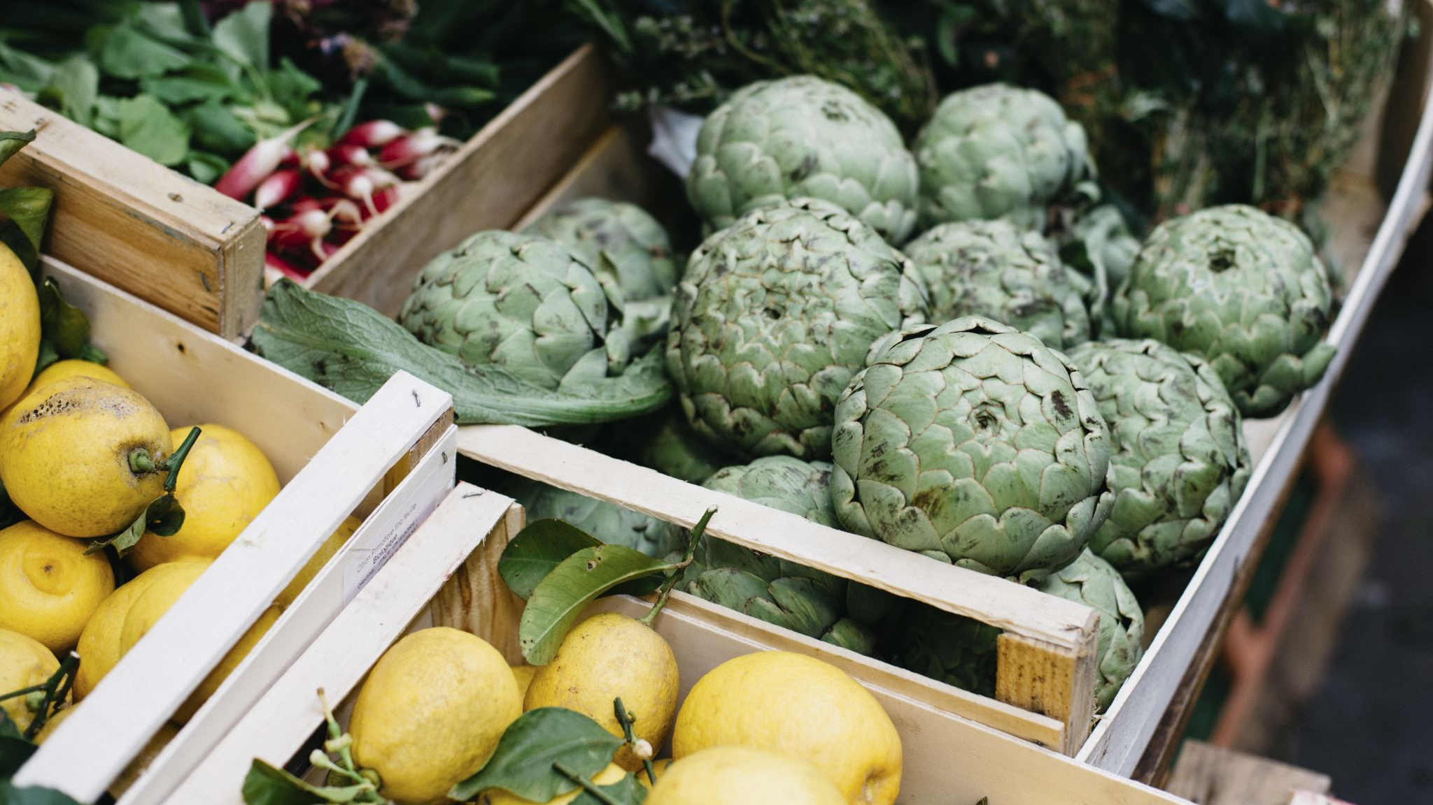
What is happening at our once majestic markets?

Slide 17
The state of fresh produce markets in SA
Our markets are in general “ ‘n bietjie vrot”.
Let us remind ourselves of the following 4 pillars:
Security.
Maintenance.
Hygiene.
Good management.
Legal action:
Matlotsana Market
Tshwane Market
Joburg Market
Many more (East London Market – Wifi)
Do we accept this?

Slide 18
Lack of operational ownership
Project Rebirth, as a voluntary project has failed.
Basic services neglected:
General upkeep.
Cleaning (failing EPWP projects).
No consignment or stock control.
Lack of visibility & couldn’t care attitudes.
Bulling tactics.
“Ons sal self” projects.
Noise!!

Slide 19
The Constitution & Markets
In Chapter 5, section 83(1) of the Local Government Municipal Structures Act, 1998 (Act 117 of 1998) specific (constitutional) functions and powers are assigned to municipalities. These powers and functions are embedded in the Constitution (section 156(1)(a)), allocating to a municipality the executive authority to administer local government matters as listed in part B, schedule 5.
This authority allows for, among other things, the establishment, control and operation of fresh-produce markets by municipalities in their areas of jurisdiction. By virtue of section 156(4), the administration of a market is assigned to local government only if it can effectively perform and administer this function locally and has the required capacity to do so.

Slide 20
Diluting the commission model (wholesalers)
Placement of a wholesaler on the Commission Market Sales Floor.
Recipe for disaster!
Disclaimer – let us talk to one another. Not all ideas must be dismissed and should be considered.
Inclusivity!

Slide 21
Claims at markets
Various claims at markets due to bad infrastructure or management.
Resulting claims not honoured by Market Authorities / Municipalities.
Claims procedure generally contained in By-laws and/or SOP’s.
Insurance turnaround time – about a month.
Accountability to farmers “should” not be the responsibility of agents!
APAC will drive this issue as a national imperative.

Slide 22
Agents A time to shine!

Slide 23
APAC & Agents
IMASA – the interface.
Together we are stronger (Indaba – 11 May 2022).

Slide 24
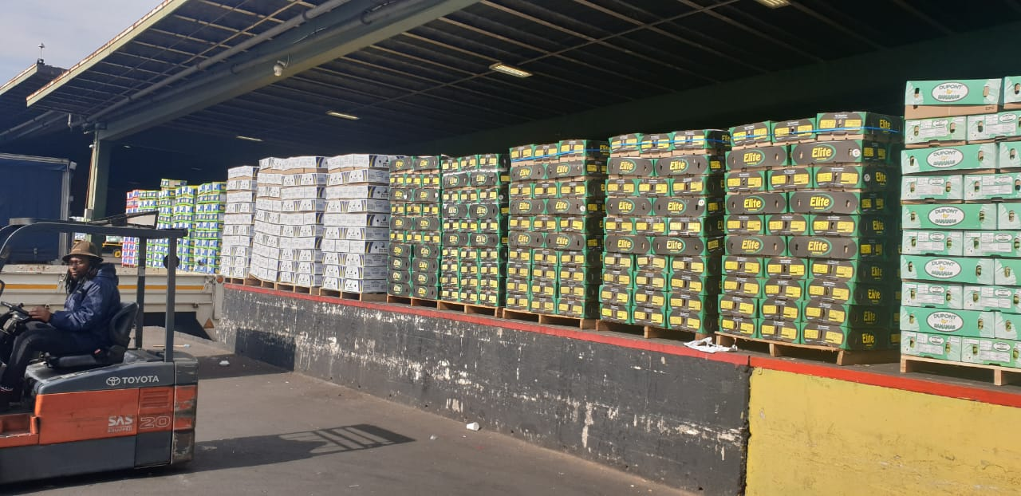
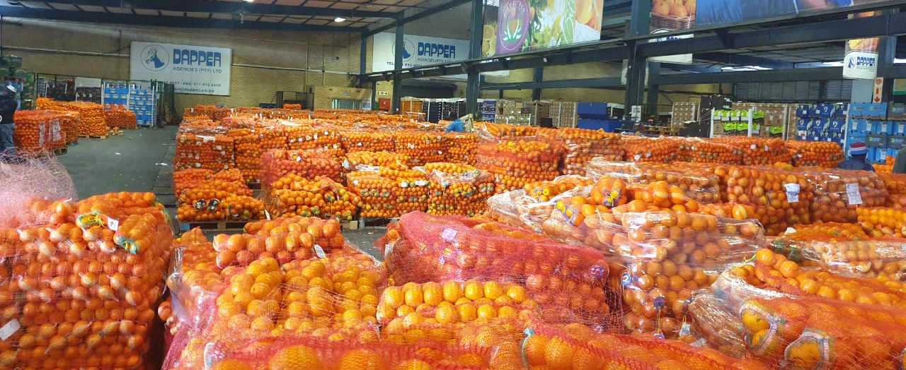
Oversupply @ markets
Problems with export.
Problems with import.
Flooding our markets:
Oranges
Bananas
Opportunity for markets to shine!
We are not in the game of “welfare”.

Slide 25
Agent Professionalism
The status & dignity of being an agent!
Integrity – through ethical trade!
Be compassionate – we serve amazing farmers!
Look the part.
Play the part (stick to the rules).
Be the best that you can be.

Slide 26
Final thoughts
No farmer – no industry!
The undeniable crucial role that agents play.
Let us talk more.
Let us rock ‘n roll in a beautiful industry.

Slide 27
Thank you

