Slide 1
South African Agriculture and Agribusiness: Prospects and Challenges
IMASA AGM
John Purchase
5 September 2019

Slide 2
For today…….
Political economy context:
- Major Global & African risks and challenges
- Major South African risks and challenges
Food Security and Competitiveness imperative
Confidence and growth in SA Agriculture
Developments in legislative and policy environment
5. Wrap up

Slide 3
Major Global Risks and Challenges
New multi-polar global power dynamic – power shift to Asia (BRICS factor NB)
Middle East tensions will continue – instability.
Brexit and European Unity: Hard Brexit most likely, negative UK economic outlook
USA vs China Trade War – impact on global trade dynamics major and irreversible, incl. WTO regime of multilateralism and dispute resolution mechanism.
Global population & Africa’s demographic ‘dividend’
Globalisation and Interconnectivity (4th IR) still a massive driver, despite general protectionist and “narrow nationalism” developments across the globe.
Mass migration an outcome of conflict and globalisation/interconnectivity - very difficult to stop.
Environmental sustainability issues, e.g. climate change and extreme weather phenomena, water availability and quality, biodiversity loss, pollution/waste, etc.
Global GDP slowdown to ~2,5%, but recession unlikely. Some downside risks still.
More interconnected ➜ but greater uncertainty ➜ less control ➜ more risk ➜ greater opportunity and reward though ➜ identify and exploit!

Slide 4
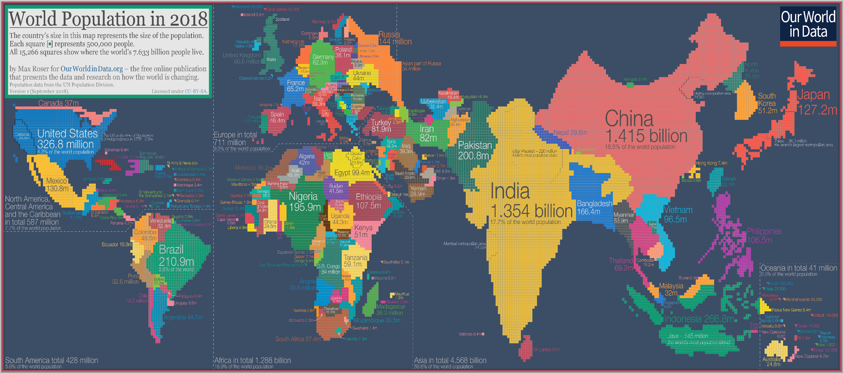
China and India = 36.2% of global population, but 18,7% of global GDP
Africa = 16.9% of global population, but <5% of global GDP
Source: World Economic Forum

Slide 5
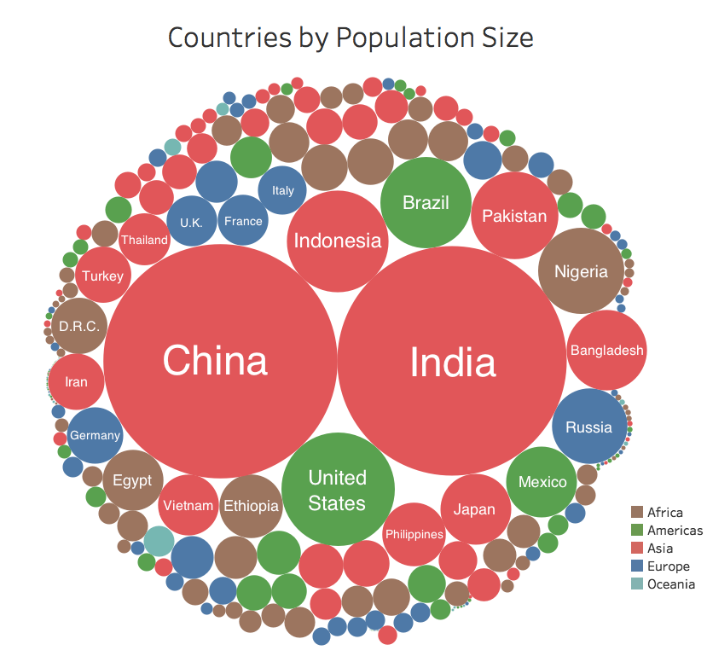
Source: World Economic Forum

Slide 6
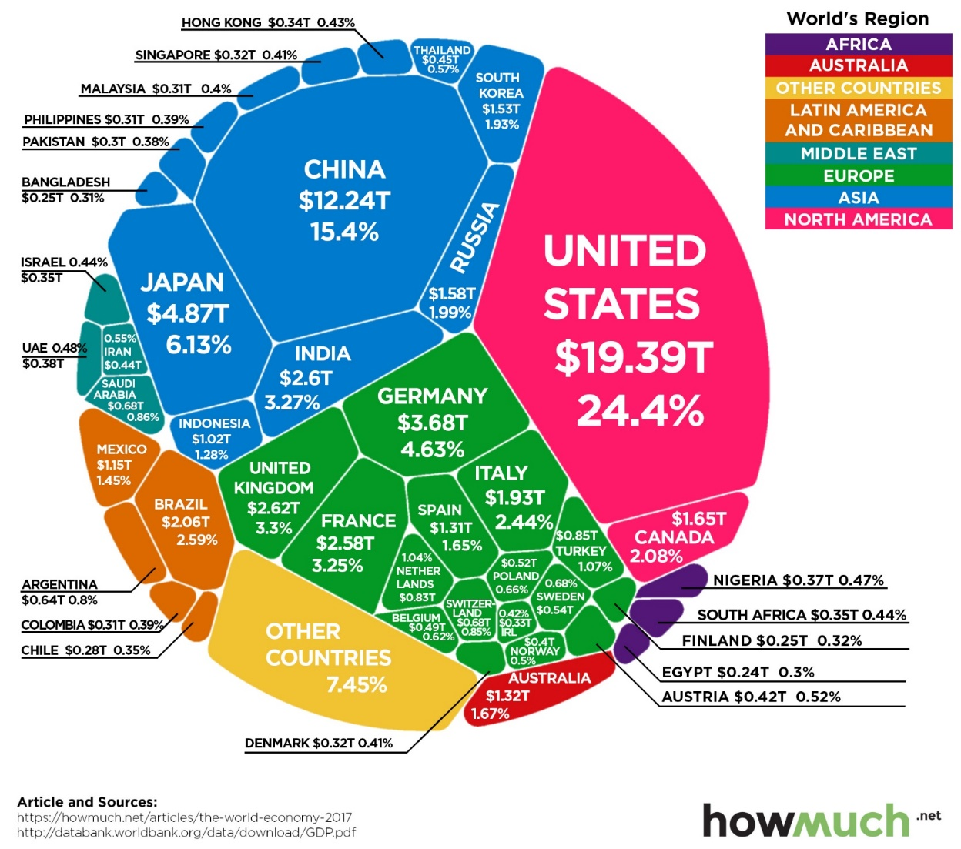
Source: World Economic Forum

Slide 7
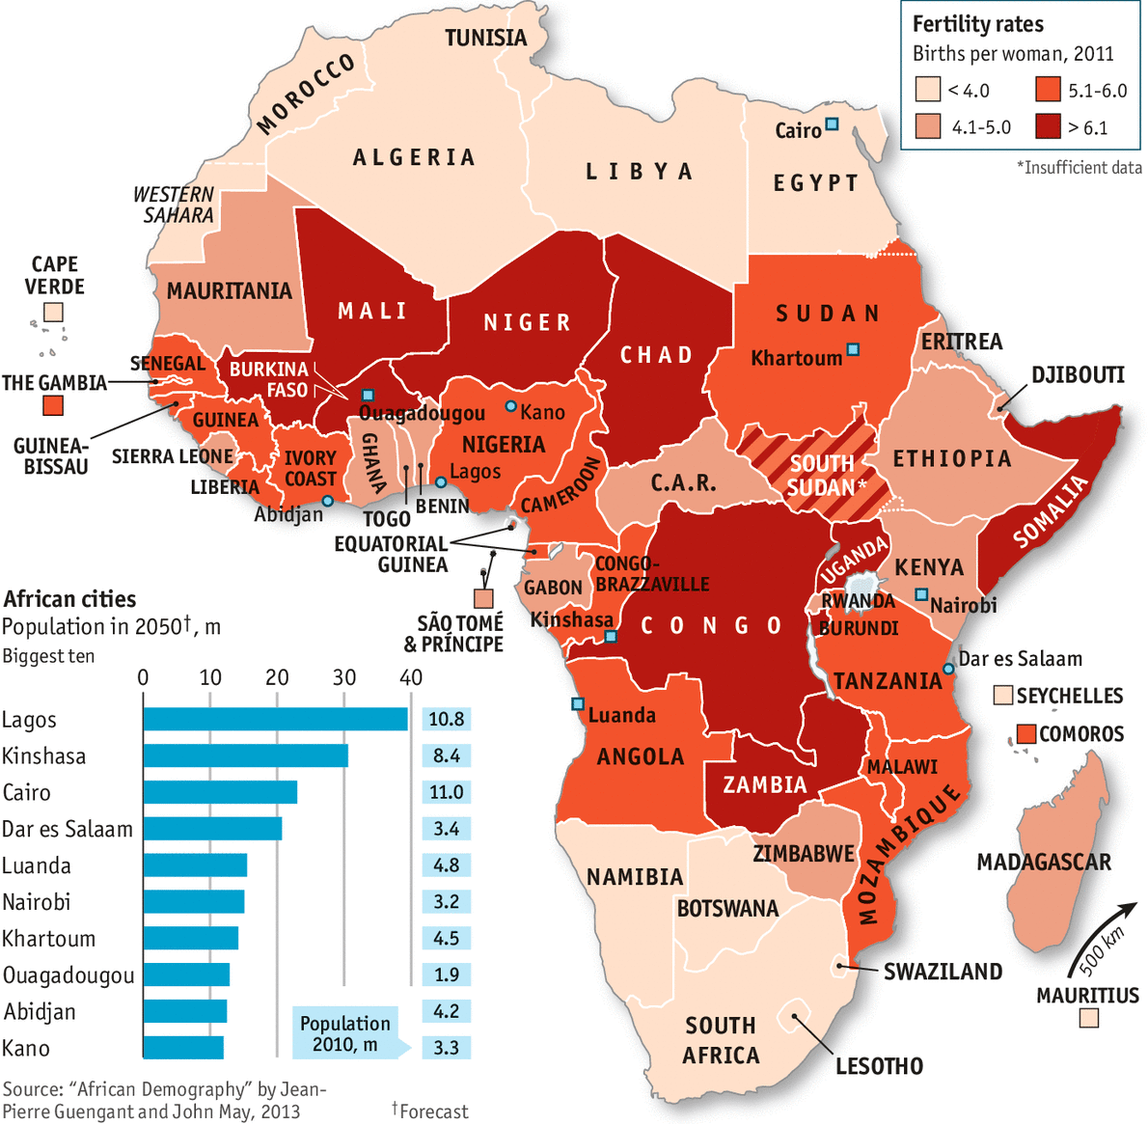
Urbanisation and Demographics…..
Africa’s population to exceed 2.0 billion by 2050.
Africa’s population to exceed 4.0 billion by 2100.
World population to reach 11.2 billion by 2100
Either massive opportunity,
or a critical risk……!

Slide 8
Major Global Risks and Challenges
New multi-polar global power dynamic – power shift to Asia (BRICS factor NB)
Ambitions of China & Russia, also India & Japan: Geo-political repositioning
Middle East tensions will continue
Brexit and European Unity: Hard Brexit most likely, negative UK economic outlook
USA vs China Trade War – impact on global trade dynamics major and irreversible, incl. WTO regime of multilateralism and dispute resolution mechanism.
Global population & Africa’s demographic ‘dividend’
Globalisation and Interconnectivity (4th IR) still a massive driver, despite general protectionist and “narrow nationalism” developments across the globe.
Mass migration an outcome of conflict and globalisation/interconnectivity - very difficult to stop.
Environmental sustainability issues, e.g. climate change and extreme weather phenomena, water availability and quality, biodiversity loss, pollution/waste, etc.
Global GDP slowdown to ~2,5%, but recession unlikely. Some downside risks still.
More interconnected ➜ but greater uncertainty ➜ less control ➜ more risk ➜ greater opportunity and reward though ➜ identify and exploit!

Slide 9
South Africa’s Political Economy: Risks & Challenges
Despite poll victory, ANC remains in turmoil – divisions and distrust persist, given various Commissions of Enquiry into respectively ‘State capture’, SARS, PIC & NPA.
Key elements of 2019 Election: 1. Low poll % - voter discontent, esp. rural areas 2. Loss of the centre to polarisation, viz. EFF and FF+ growth 3. Smaller parties not really a factor.
Improved political certainty, with solid mandate for President Ramaphosa. However, can he act to do what he knows has to be done? Difficult decisions have to be made.
Biggest concern: Lack of GDP growth and Competitiveness decline (WEF)
State capability a major concern – evidenced in DAFF & DRDLR. Also other Dept’s/SOE’s.
Massive unemployment (>29%), especially amongst the Youth (>50%).
Inequality – SA top of GINI Coefficient (WEF, 2018): populist calls & demands will persist.
Service delivery and other protests increasing, and more violent (ISS).
Land & water reform will be at the centre of demands. Even nationalisation pressure on banks & mines, e.g. Reserve Bank.
Crime & Security factor, including corruption and farm/rural safety, a real concern.

Slide 10
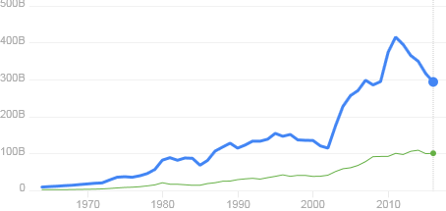
South Africa’s GDP: 347,7 billion USD (2018)
416.9 billion USD in 2011
South Africa
US$
(Billion)
294,8 billion USD in 2016
Morocco
Year
2011 GDP per capita (US$) = 8,066
2016 GDP per capita (US$) = 5,261
2018 GDP per capita (US$) = 6,180
Source: WEF Competitiveness Reports

Slide 11
South Africa’s growth has decoupled from global growth
Source: Bloomberg, Agbiz Research

Slide 12
Business confidence leads fixed investment
Source: BER, SARB, Agbiz Research

Slide 13
Heading for 68%
Rating agencies? Only Moody’s still investment grade, but negative outlook.
Fitch: further downgrade to negative sub-investment grade

Slide 14
South Africa’s Political Economy: Risks & Challenges
Despite poll victory, ANC remains in turmoil – divisions and distrust will persist, given various Commissions of Enquiry into respectively ‘State capture’, SARS, PIC & NPA.
Key elements of 2019 Election: 1. Low poll % - voter discontent, esp. rural areas 2. Loss of the centre to polarisation, viz. EFF and FF+ growth 3. Smaller parties not really a factor.
Improved political certainty, with solid mandate for President Ramaphosa. Can he act to do what he knows has to be done? Difficult decisions have to be made.
Biggest concern: Lack of GDP growth and Competitiveness decline (WEF)
State capability a major concern – evidenced in DAFF & DRDLR. Also other Dept’s/SOE’s.
Massive unemployment (>29%), especially amongst the Youth (>50%)
Inequality – SA top of GINI Coefficient (WEF, 2018): populist calls & demands will persist.
Service delivery protests increasing, especially rural areas, and more violent (ISS).
Land & water reform will be at the centre of demands. Also nationalisation pressure on banks & mines, e.g. Reserve Bank now.
Crime & Security factor, including corruption and farm/rural safety, a major concern.

Slide 15
For today…….
Political economy:
- Major Global & African risks and challenges
- Major South African risks and challenges
Food Security and Competitiveness imperative
Confidence and growth in SA Agriculture
Legislative and policy environment
5. Wrap up

Slide 16
Food Security Imperative

Slide 17
Components of Food Security
FOOD QUALITY & SAFETY (5)
Nutritional standards
Protein quality
Food safety, etc.
FOOD AFFORDABILITY (6)
Food consumption as % of DHI
% of pop under GPL (<US$3.10)
Presence of Food Safety Net Programmes, Etc.
FOOD AVAILABILITY (8)
Sufficiency of supply
Volatility of agric production
Agricultural infrastructure
R&D spend, etc.
Food Security
Complex concept:
Difficult to measure
and evaluate.
Purchasing power
key to access
Stability over TIME

Slide 18
2017 Global Food Security Index
2018: South Africa ranks 47th
SA Household Food Security a risk: ~20% of households food insecure
Source: Economist Intelligence Unit/DuPont
http://foodsecurityindex.eiu.com.

Slide 19
Competitiveness Imperative

Slide 21
South Africa
= 47th
= 61st
= 67th

Slide 22
Agro-food Value Chain competitiveness
Analysis on:
Relative Trade Advantage
Comparative Advantage
Competitive Advantage
Porter diamond analysis (Participative analysis)
Pioneered by Agbiz (Prof Johan van Rooyen and Dirk Esterhuizen) in early 2000’s. Still done!

Slide 23
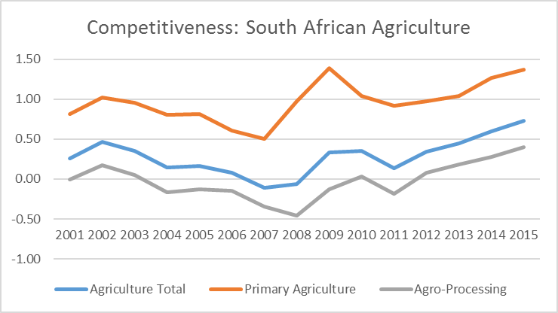
South African Agricultural Sector

Slide 24
SA has now become a net exporter of beef
Source: Trade Map, Agbiz Research

Slide 25
For today…….
Political economy:
- Major Global & African risks and challenges
- Major South African risks and challenges
Food Security and Competitiveness imperative
Confidence and growth in SA Agriculture
Legislative and policy environment
5. Wrap up

Slide 26
Subsector Performance
5 year average share
Subsector Performance: Gross Production Value
Notes:
Main contributors within each Ag subsector
Performance of subsectors:
Field crops flat & declining since 2014
Livestock up once volumes recover – good performer historically
Horticulture up later in projection:
Recovery from drought volumes
Young orchards established, time to enter full production
Water response & Expansion

Slide 27
RSA Agriculture, Forestry & Fisheries GDP: 2005 -2018
Source: Agbiz, Stats SA

Slide 29
Inconsistencies in policy impacts agricultural business confidence and investment
(Shaded areas indicate periods when rainfall across South Africa was below the average level of 500 millimetres)
Source: Agbiz Research

Slide 30
Fortunately, there has not been disinvestment in SA agriculture thus far
Source: South African Reserve Bank, Statistics South Africa, Agbiz Research

Slide 31
Evolution of farm sizes in SA: mechanisation has been key on this process
Source: Liebenberg, Stats SA, BFAP, Agbiz Research

Slide 32
…but mechanisation has largely been funded by debt from local institutions
FDI in SA agriculture on a decline
SA farm debt growing
Source: SARB, DAFF, Agbiz Research

Slide 33
SA’s Agricultural imports, exports & trade balance
Source: ITC, Agbiz Research

Slide 35
Indexed GDP: Agro-processing vs Manufacturing Output
Agro-processing: ~25% of MO and ~3.5% of GDP

Slide 36
24 of 36 commodities SA a net exporter = 67%
Source: BFAP, 2016

Slide 37
High-growth industries are on track
Gross Value of Agricultural Production
Source: DAFF, 2019
Notes:
Certain industries performed better

Slide 38
For today…….
Political economy:
- Major Global & African risks and challenges
- Major South African risks and challenges
Food Security and Competitiveness imperative
Confidence and growth in SA Agriculture
Legislative and policy environment
5. Wrap up

Slide 39
The current policymakers’ thinking revolve around these aspects
Inclusive growth and jobs creation
Land reform
Climate change
Water rights regulations and water infrastructure
Infrastructure constraints in some farming areas, particularly former homelands
International trade matters (market access, and expansion of export markets)

Slide 40
Title of presentation
So for today…
Presidential Land & Agriculture Reform Advisory Panel Report, ‘Expropriation without compensation’ and other land policies/legislation
Environmental and natural resource legislation
Jobs Summit developments
Public-Private Growth Initiative

Slide 44
Fields of policy and legislation
Credit legislation: National Credit Amendment Bill passed by Parliament and assented.
National Credit Act: Regulation 23A: Affordability assessment (flexibility required for Agric sector)
Carbon Tax Act (implemented) and Climate Change Bill (In Nedlac) - contentious
Labour legislation: NMWA + LRAA + BCEAA (Nedlac package) – Exemption system problem?
Water rights and water security:
- Water Masterplan & Water Phakisa – New Water Bill & ELU?
- Water licence application regulations & Water tariffs (Independent regulator?)
5. Land reform:
- Expropriation without Compensation – Re-establishment of Parliamentary subcommittee to
propose wording to National Assembly
- Regulation of Agricultural Landholdings Bill – in Nedlac but suspended.
- Valuation Regulations (Property Valuation Act) – Recent Court judgement vital and welcomed.
- Communal Land Tenure Bill (Comments in 2017 – no progress?)
- Communal Property Association Amendment Act (passed but not assented)
- Preservation & Development of Agricultural Land Framework Bill (DAFF Bill) – currently in
Nedlac and contentious. Constitutional challenge?
6. Other

Slide 46
Fields of policy and legislation
Credit legislation: National Credit Amendment Bill passed by Parliament (not assented).
National Credit Act: Regulation 23A: Affordability assessment (flexibility required for Agric sector)
Carbon Tax Act (implemented) and Climate Change Bill (In Nedlac) - contentious
Labour legislation: NMWA + LRAA + BCEAA (Nedlac package) – Exemption system problem?
Water rights and water security:
- Water Masterplan & Water Phakisa – New Water Bill & ELU?
- Water licence application regulations & Water tariffs (Independent regulator?)
5. Land reform:
- Expropriation without Compensation – Re-establishment of Parliamentary subcommittee to
propose wording to National Assembly
- Regulation of Agricultural Landholdings Bill – in Nedlac but suspended.
- Valuation Regulations (Property Valuation Act) – Recent Court judgement vital and welcomed.
- Communal Land Tenure Bill (Comments in 2017 – no progress?)
- Communal Property Association Amendment Act (passed but not assented)
- Preservation & Development of Agricultural Land Framework Bill (DAFF Bill) – currently in
Nedlac and contentious. Constitutional challenge?
6. Other

Slide 50
Fields of policy and legislation
Credit legislation: National Credit Amendment Bill passed by Parliament and assented (13 Aug).
National Credit Act: Regulation 23A: ‘Affordability assessment’ contentious for agriculture.
Carbon Tax Act (implemented) and Climate Change Bill (In Nedlac) - contentious
Labour legislation: NMWA + LRAA + BCEAA (Nedlac package) – Exemption system problem?
Water rights and water security:
- Water Masterplan & Water Phakisa – New Water Bill & ELU?
- Water licence application regulations & Water tariffs (Independent regulator?)
5. Land reform:
- Expropriation without Compensation – Re-establishment of Parliamentary subcommittee to
propose wording to National Assembly
- Regulation of Agricultural Landholdings Bill – in Nedlac but suspended.
- Valuation Regulations (Property Valuation Act) – Recent Court judgement vital and welcomed.
- Communal Land Tenure Bill (Comments in 2017 – no progress?)
- Communal Property Association Amendment Act (passed but not assented)
- Preservation & Development of Agricultural Land Framework Bill (DAFF Bill) – currently in
Nedlac and contentious. Constitutional challenge?
6. Other

Slide 52
1. NEDLAC:
- Jobs Summit developments
- Trade & Industry Chamber
2. Public-Private Growth Initiative (PPGI)

Slide 53
Presidential Jobs Summit Agreements
First Progress report
Report to the Presidential Committee
01 August 2019

Slide 54
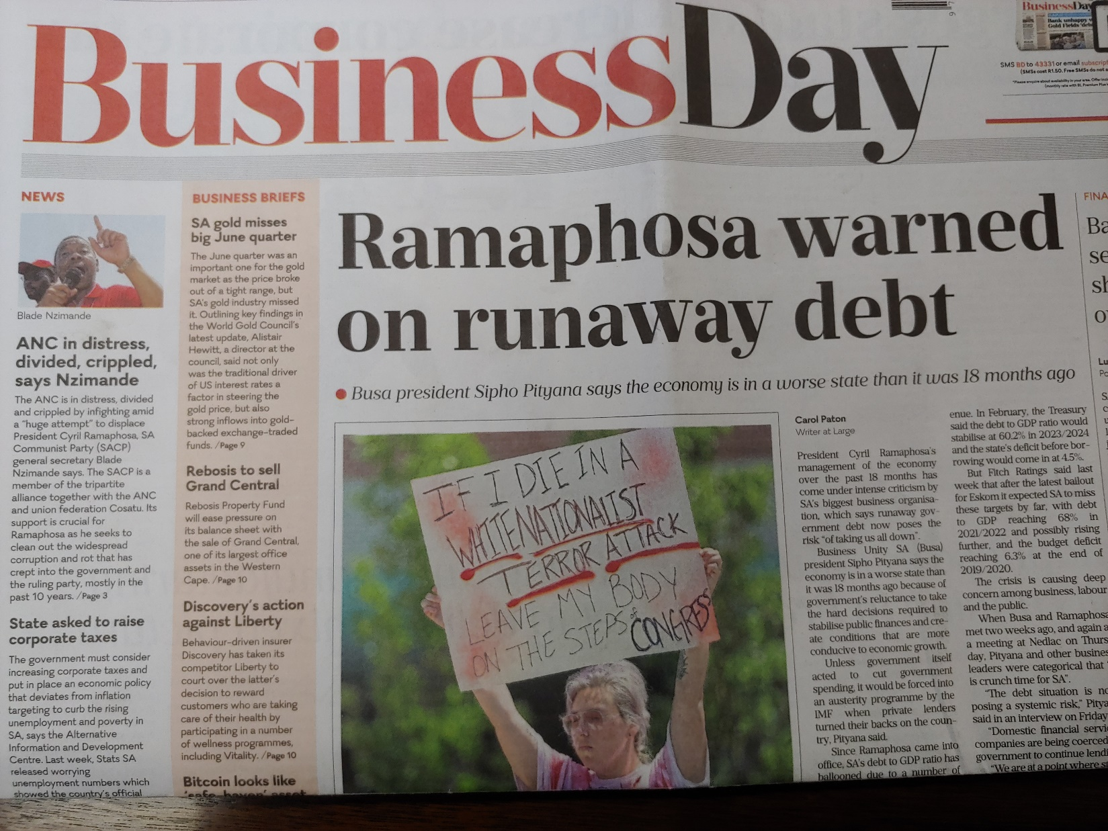
Jobs Summit developments

Slide 55
Nedlac TIC Strategic Session
Hosted by Minister Ebrahim Patel: totally new approach and welcomed.
Emphasized 6 major focus areas, viz.:
Expand markets for our products and facilitate entry to those markets
Support improved industrial performance, dynamism and competitiveness of local companies.
Improve the levels of investment in the economy and help to achieve the target set by the President in SONA last year.
Promote economic inclusion. (Competition legislation & B-BBEE)
Promoting more equitable spatial and industrial development. (e.g. SEZ’s)
Improve the capability of the state. (CIPC example)
Two cross-cutting themes for all 6 initiatives:
(i) Partnerships & (ii) Inclusion & Transformation

Slide 56
Nedlac TIC Strategic Session (Continued)
Following broad discussion, Minister announced establishment of the following structures:
  A National Committee on the African Continental Free Trade Agreement.
  A Ministerial Export Promotion Panel. Seven seats for Business and 3 for Labour.
  An SEZ Reference Group, with 5 seats for Business.
  A Port Charges Joint Committee, chaired by André de Ruyter and Yunus Hoosen.
  A 1-day session on the Technical Regulatory Agencies will be convened, to be preceded by the DTIC reviewing whether the existing regulations are conducive to growing the economy.
  An engagement on addressing Business’ concerns regarding the functioning of SETAs to be held. Paul Theron (Business) and André Kriel (Labour) to draft a concept note.
  A Special Ministerial Session on BEE will be convened to endeavour to establish a broad-based BEE framework that maximises impact while minimising costs on business.
  A Committee on Digital Trade, with 2 seats per constituency.

Slide 57
Public-Private Growth Initiative
Dr Johan van Zyl, Roelf Meyer & Min Dlamini-Zuma (DPME)
Reference in SONA, Ministry Budget Vote speeches and other forums
Now transferred to Invest SA within DTIC
Agbiz raised concern as coordinator for agro-industry value chains
While MTSF 2019-2024 not yet available, clear that major elements raised in the 5-Year Agric Value Chain Plan will be incorporated into MTSF.
Three projects from Agriculture VC: (1) ADA (2) Citrus Industry (market access & logistics primarily) (3) Beefmaster
Will continue to drive process to create an improved investment and business environment.

Slide 58
Wrap up………
Relatively healthy and robust agri-food industry, but under pressure.
Challenges: Investment environment, Agro-logistics, water availability and quality, environmental sustainability, R&D, crime and security, labour relations & legislation, land reform, climate change, droughts, trade agreements, sustainable transformation, etc.
Opportunities: Growing population, consumer spending trends, new markets (especially to Africa and Asia), new technologies & improved productivity, etc.
Major contributor to Food Security, growth and employment in RSA – major South African asset.
But we live in uncertain times – many risks and variables, some controllable, others not or less so.
However, risk creates opportunity and reward, and concentrate on those risks and opportunities you understand and can manage!

Slide 59
Thank you
Questions or comments?

